Slide 1


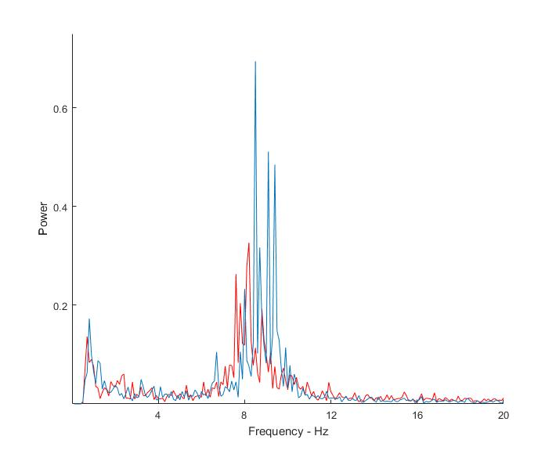
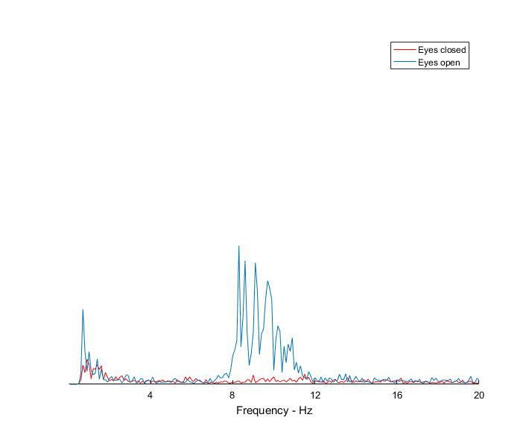
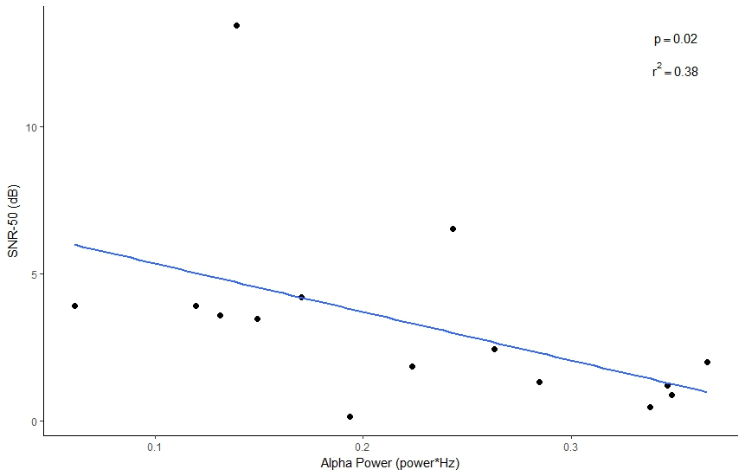
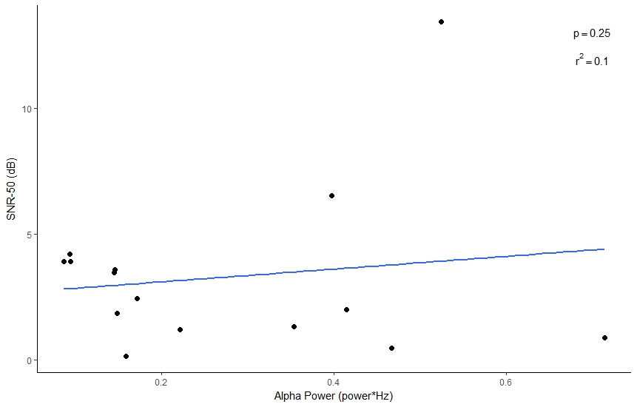
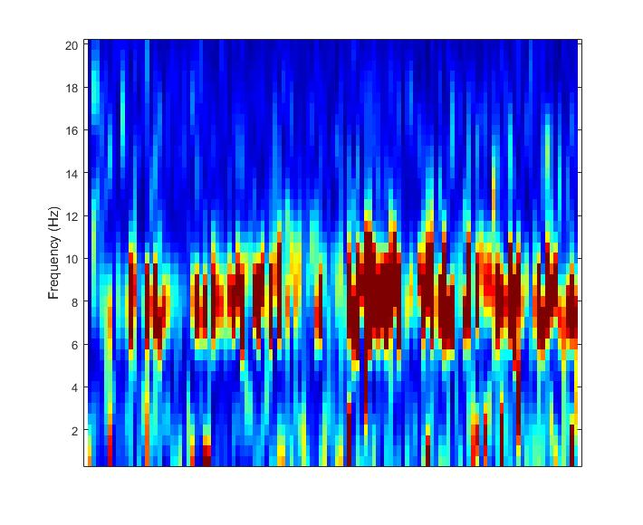
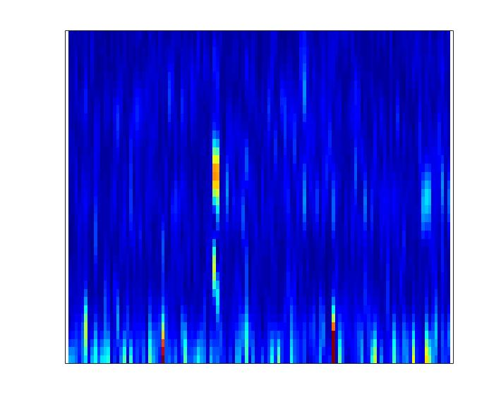

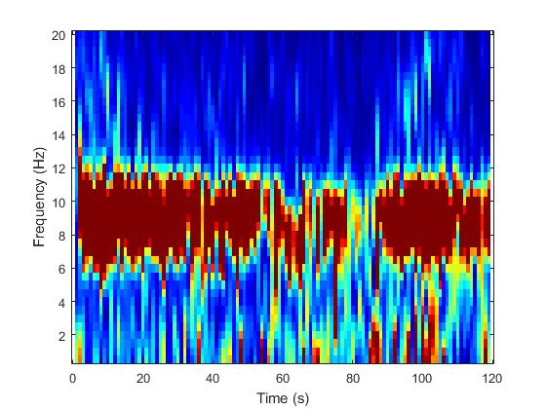
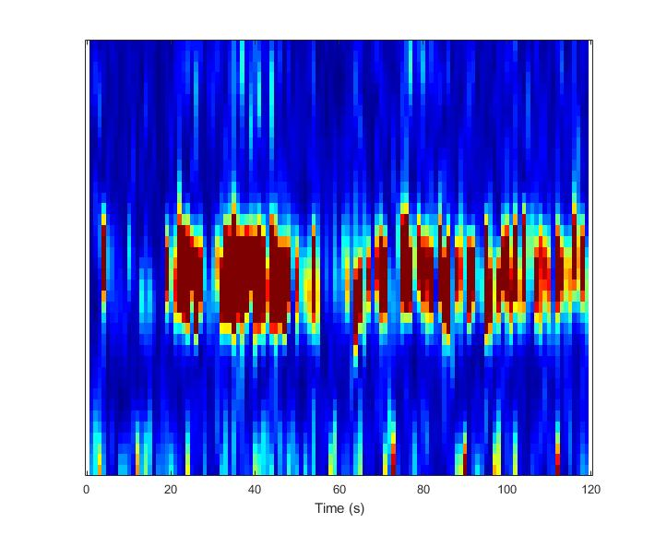
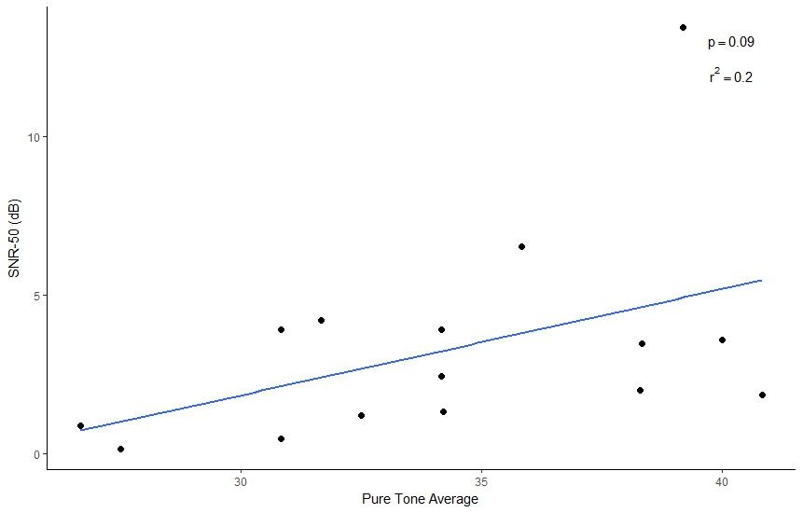
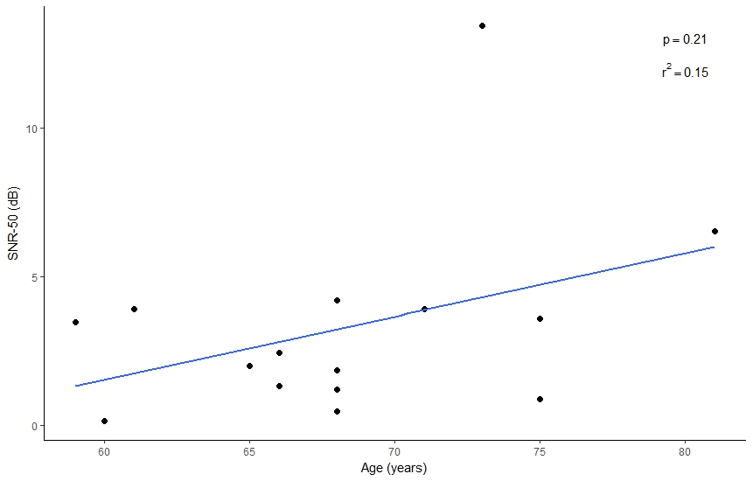
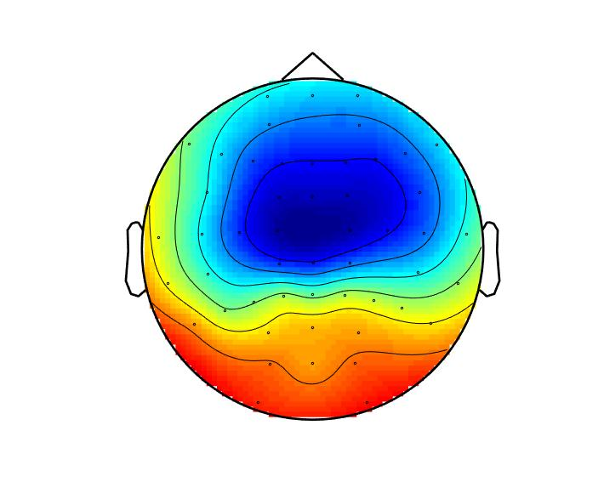
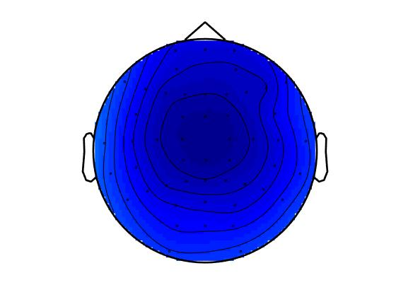
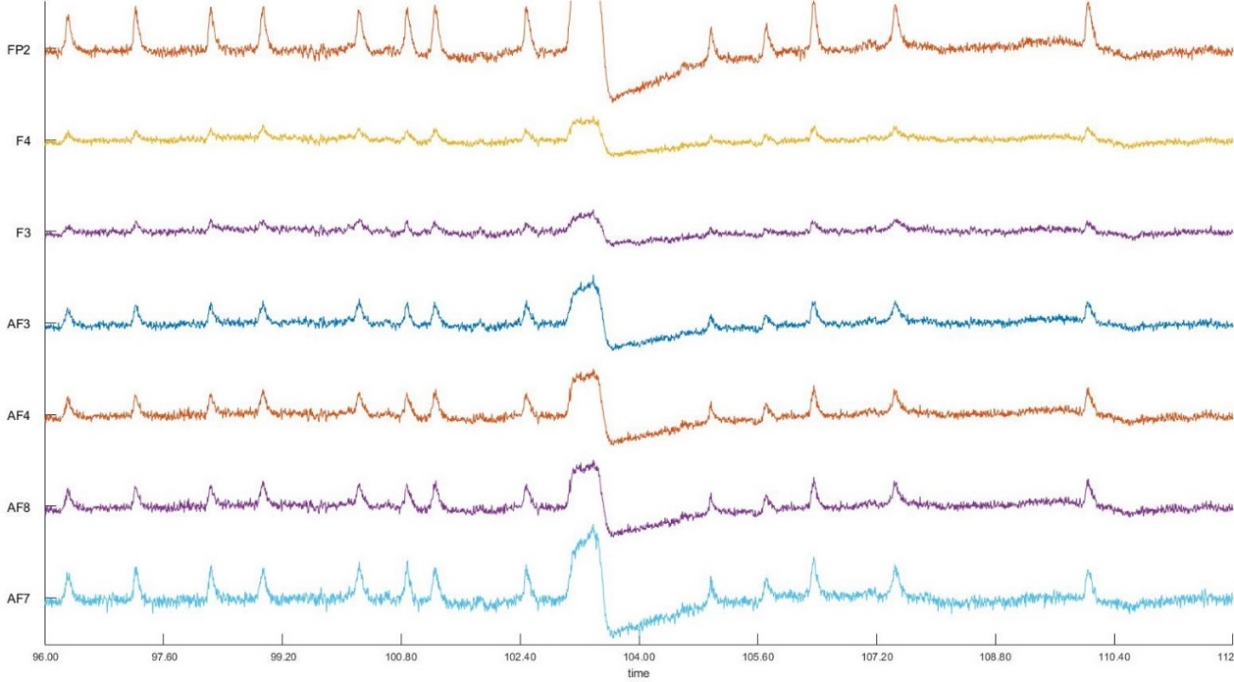
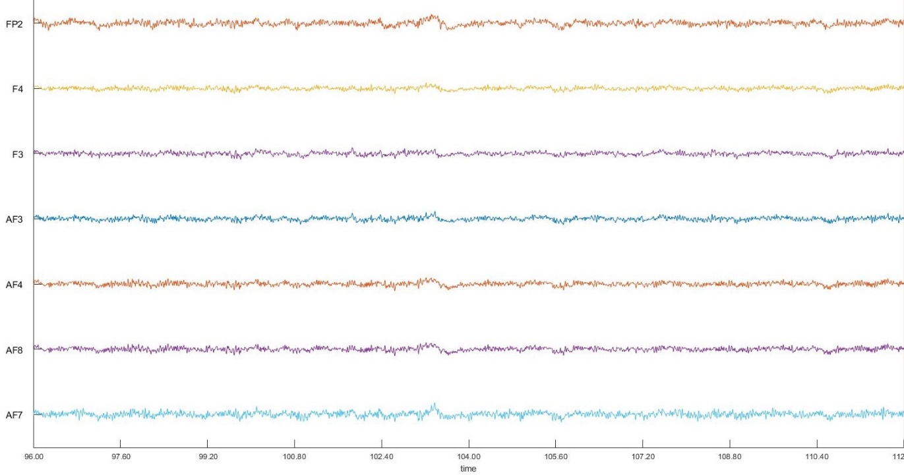

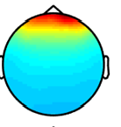
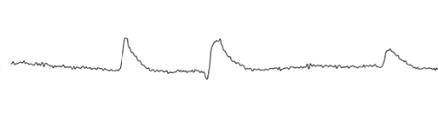
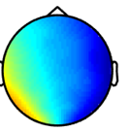
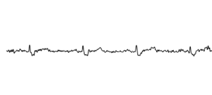
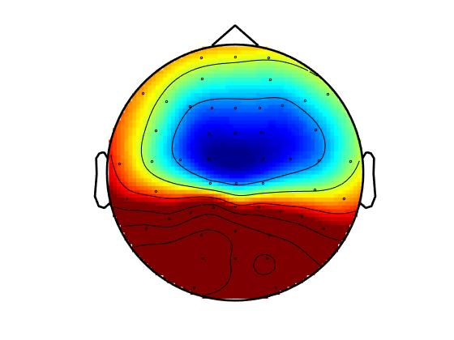
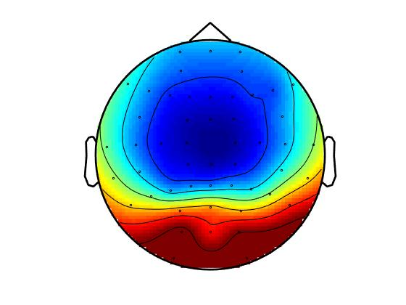
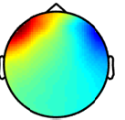
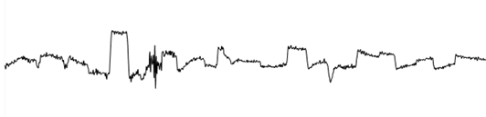
Variations in speech-in-noise thresholds as it relates to central inhibitory function
Michael L. Smith¹, Michael L. Lee¹, Christi W. Miller¹, Yu-Hsiang Wu², Ruth A. Bentler², & Kelly L. Tremblay¹
1. Department of Speech & Hearing Sciences, University of Washington, Seattle, WA USA
2. Department of Communication Sciences & Disorders, University of Iowa, Iowa City, IA USA
1. Introduction
3. Results
3. Results Continued
objectives
Speech understanding in the presence of background noise is a major issue for individuals with hearing impairment
Effects of aging and hearing loss on central inhibitory function could potentially contribute to poor speech in noise (SIN) performance
Cortical alpha (7.5-12.5Hz) activity is an indirect measure of central inhibition, and relates to speech understanding in noise
Alpha rhythms effect on SIN testing has been well studied, but less is known about how individual resting state alpha relates to SIN performance.
Increased alpha activity is believed to aid in the suppression of background noise as the listener focuses on the relevant signal stream, however decreases in cortical areas related to attention
Purpose of the present study was to examine if an individual’s inhibitory function, as defined by their resting state alpha activity, would predict signal to noise ratio (SNR) thresholds
Resting state alpha activity in the eyes open condition varied among hearing aid patients
SNR thresholds significantly associate with alpha power
 | Estimate co-efficient | Standard error | P-value
Alpha power eyes open | -39.7 | 12.6 | 0.008**
Alpha power eyes closed | 19.0 | 6.4 | 0.01*
FFT – occipital channels
2. Methods
Table 1. Linear regression model (y=β₀+ β₁X₁+ β₂X₂) where y=SNR-50 threshold, X₁=alpha power eyes open, X₂=alpha power eyes closed
Decreased SNR thresholds were associated with increased alpha power
Participants: Adult bilateral hearing aid users (n = 15), age 59-81 (mean = 68.3)
Mild-moderate hearing loss
All subjects wore hearing aids for at least two years prior to testing
All testing was performed unaided
Baseline resting state activity was recorded in a silent, dark environment
EEG Recording
65 channel Neuroscan system
Online sampling rate of 1000Hz
Alternating 2 minute blocks of eyes open/eyes closed
Three blocks per condition
SNR Testing
Presented in sound field, single speaker 0° azimuth, 1m away
Noise:4-talker babble in international languages
English sentences presented -10 to +15 SNR in 5dB steps
Noise held constant at 65dB SPL
Data Analysis Pipeline
Alpha power was calculated in Fieldtrip, a MATLAB based toolbox
Trials were defined as eyes open or eyes closed
Bandpass filtered 0.5-50Hz
Down sampled to 250Hz
Independent Component Analysis (ICA) was used to remove biological artifacts such as eye blinks, eye movements, electrocardiogram (EKG), as well as noisy channels (i.e. 60Hz line noise)
ICA was conducted over the continuous EEG recording data
Average of 3-5 components removed per subject
background
Alpha power averaged across occipital channels
Figure 3. Significant correlations between SNR thresholds and alpha power during the eyes open condition. Alpha power was calculated as area under the curve from the FFT power spectrum in the alpha frequency band.
Figure 4.
Topographical representation of alpha band power
4. Conclusions
Alpha power was primarily concentrated to occipital electrodes
Subject variability in alpha power was recorded
Alpha power was greater in the eyes closed condition compared to eyes open
SNR-50 thresholds decreased as a function of alpha power during the eyes open condition, and increased during eyes closed
Audibility and age did not significantly contribute to SNR-50 thresholds
EEG alpha power may be predictive of SNR-50 threshold outcome measures
Figure 1. Raw EEG data before and after removal of biological artifacts using ICA.
References
Figure 2. Individual subject differences in time frequency data during the eyes open condition. Notice in the top row (subject 1) the increased activation in the alpha band (7.5-12.5Hz), while the bottom row (subject 2) shows no activation across different frequency bands.
Conclusion 1
Conclusion 2
Conclusion 3

